Slide 1
Initiate Agency Review

Slide 2


Slide 3
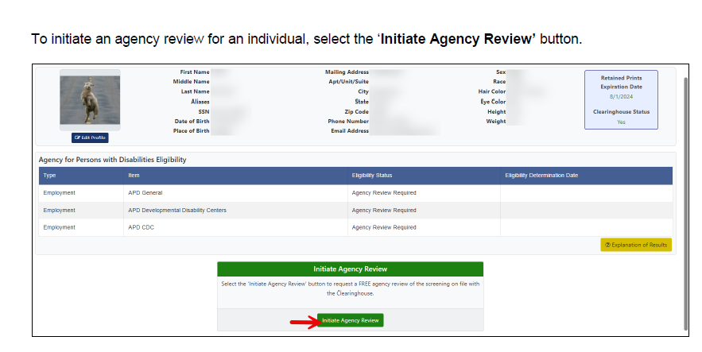

Slide 4
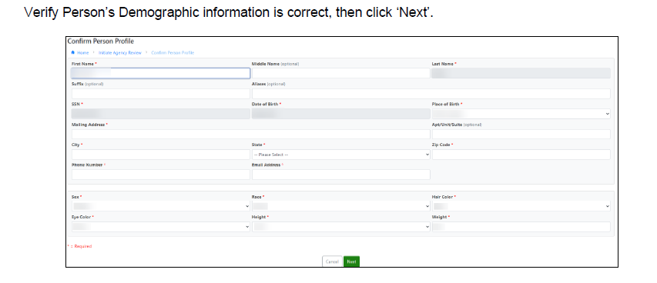

Slide 5


Slide 6


Slide 7
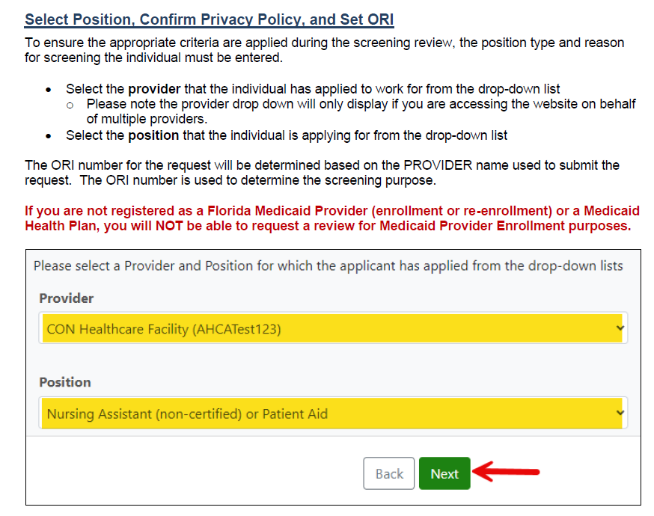

Slide 8
